Slide 1


Luís Fortes
24 of July 2023

Slide 2

Outline
Executive Summary
Introduction
Methodology
Results
Conclusion
Appendix

Slide 3
Executive Summary
Data Collection
(api/webscraping)
Data Wrangling
Exploratory Data Analysis
(SQL)
Exploratory Data Analysis
(Visualization)
Interactive Visuals
(Folium)
Predictive ML Analysis
(classification)
Plotly Dashboard
METHODOLOGIES

Slide 4
Executive Summary
RESULTS
Exploratory Data Analysis
Interactive Analytics
Predictive Analytics

Slide 5

Introduction
Predicting Falcon 9 First Stage Landing Success
One of the key innovations introduced by SpaceX is the reusable rocket technology, particularly exemplified by the Falcon 9 rocket. By reusing the first stage of the Falcon 9 rocket, SpaceX has been able to drastically reduce the cost of launching payloads into space, making space missions more accessible and cost-effective.
The main objective of this data science project is to build a predictive model that can determine the likelihood of the Falcon 9 first stage landing successfully during rocket launches and this determine the cost of a launch.

Slide 6

Section 1

Slide 7
Methodology
Executive Summary
Data collection methodology:
SpaceX API
Web scraping from Wikipedia
Perform data wrangling
One-Hot Encoding
Perform exploratory data analysis (EDA) using visualization and SQL
Perform interactive visual analytics using Folium and Plotly Dash
Perform predictive analysis using classification models
How to build, tune, evaluate classification models

Slide 8
Data Collection
Data was collected through:
SpaceX API
Data collected via get request
Decoded the data as JSON ( .json() method ) and transformed it into a dataframe using built in pandas method normalize ( .json_normalize() ).
Web Scraping
Scrapped the SpaceX data from Wikipedia , using a python the python library BeautifulSoup. Gathered the response as HTML tables, parsed the tables and converted it into a pandas dataframe.

Slide 9
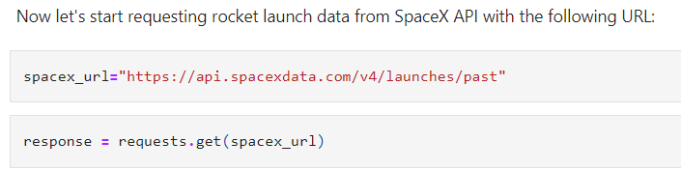
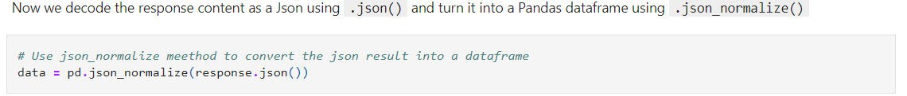
Data Collection – SpaceX API
https://github.com/0xfortes/IBM-Data-Science/blob/main/Capstone%20SpaceX/jupyter-labs-spacex-data-collection-api.ipynb

Slide 10
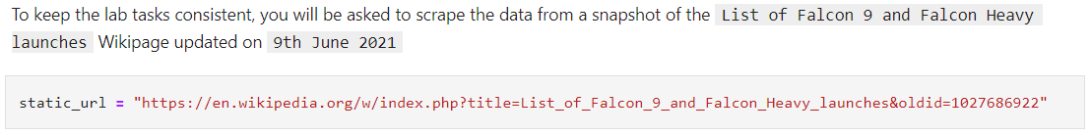
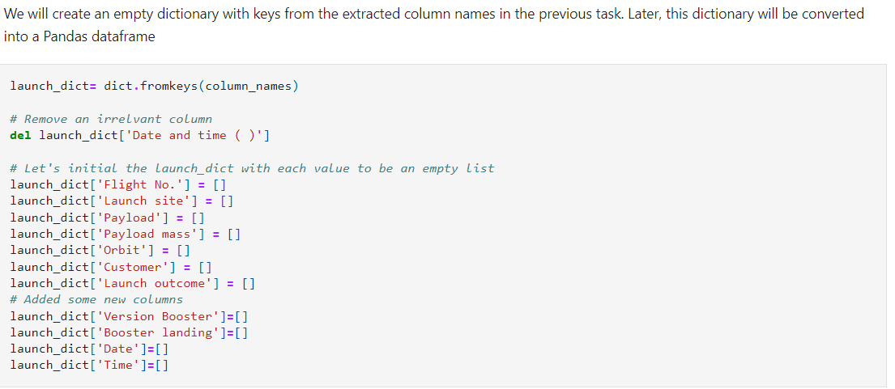
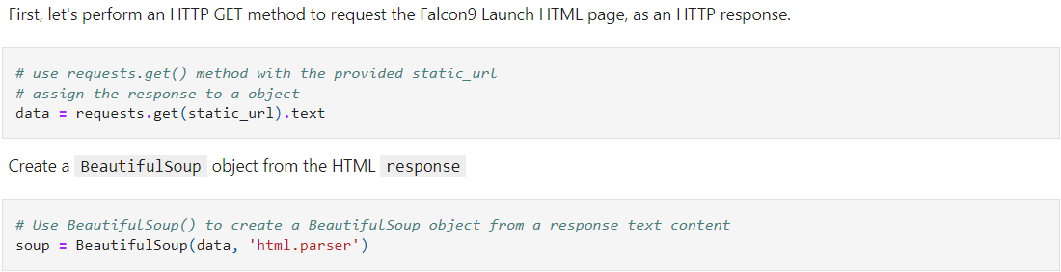
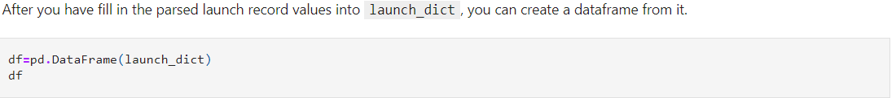
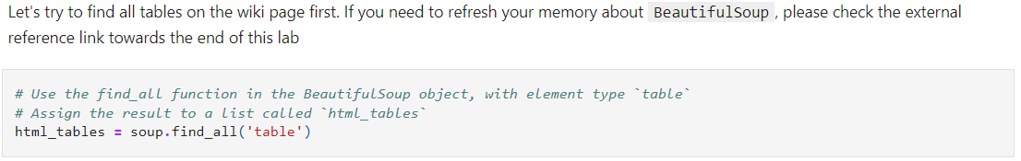
Data Collection – Scraping
https://github.com/0xfortes/IBM-Data-Science/blob/main/Capstone%20SpaceX/jupyter-labs-webscraping.ipynb

Slide 11
Data Wrangling
https://github.com/0xfortes/IBM-Data-Science/blob/main/Capstone%20SpaceX/labs-jupyter-spacex-data_wrangling_jupyterlite.jupyterlite.ipynb
Performed EDA (exploratory data analysis) to determine the training labels
Calculated the number of launches at each site
Calculated the number and occurrence of each orbit
Calculated the number and occurrence of mission outcome per orbit type
Created a landing outcome label from the outcome column.
In order to work with numerical values, we assigned 0 to bad outcomes (unsuccessful landing) and 1 to successful outcomes.

Slide 12
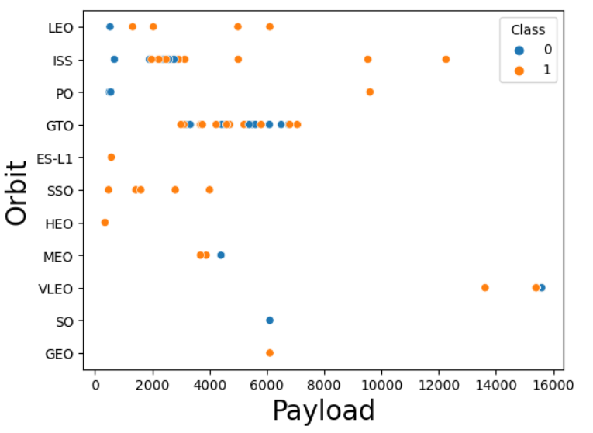
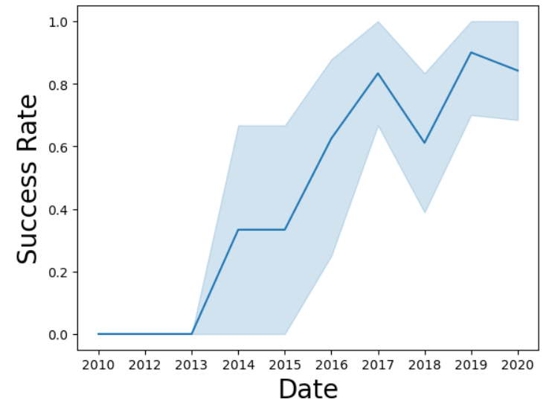
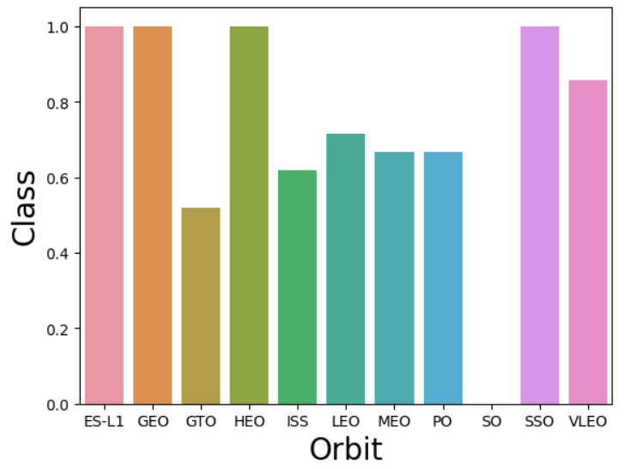
EDA with Data Visualization
https://github.com/0xfortes/IBM-Data-Science/blob/main/Capstone%20SpaceX/jupyter-labs-eda-dataviz.ipynb.jupyterlite.ipynb
Data Visualization conducted
Scatter plot relationships between: Flight Number & Launch Site, Launch Site & Payload, Flight Number & Orbit Type, Payload & Orbit Type (only one example was provided below)
Line chart to visualize the yearly trend of the launch success rate
Bar chart to visualize the relationship between the success rate of each orbit type

Slide 13
EDA with SQL
https://github.com/0xfortes/IBM-Data-Science/blob/main/Capstone%20SpaceX/jupyter-labs-eda-sql-edx_sqllite.ipynb
SpaceX dataset was loaded into a SQL database
Applied SQL queries to get insights from the dataset
Display the names of the unique launch sites in the space mission,
Display the total payload mass carried by boosters launched by NASA (CRS),
Display average payload mass carried by booster version F9 v1.1,
Total number of successful and failure mission outcomes,
Names of the booster versions which have carried the maximum payload mass,
Rank the count of landing outcomes (such as Failure (drone ship) or Success (ground pad)).

Slide 14
Build an Interactive Map with Folium
https://github.com/0xfortes/IBM-Data-Science/blob/main/Capstone%20SpaceX/lab_jupyter_launch_site_location.jupyterlite.ipynb
Components added to the Folium Map
Marked launch sites and added map objects such as highlighted circles, color labeled markers and lines to have a visual impact of the success or failure of the launches in each site.
Assigned the feature launch outcomes to our class (successful = 1, failed = 0)
Calculated distances between launch sites and its proximities (railways, highways, coastlines), in order to answer the following questions:
Are launch sites in close proximity to railways?
Are launch sites in close proximity to highways?
Are launch sites in close proximity to coastline?
Do launch sites keep certain distance away from cities?

Slide 15
Build a Dashboard with Plotly Dash
https://github.com/0xfortes/IBM-Data-Science/blob/main/Capstone%20SpaceX/spacex_dash_app.py
The following components were added to the interactive plotly dashboard:
Functionalities
Added a dropdown list to enable Launch Site selection
Add a slider to select payload range
Plots
Pie charts to show the total successful launches count for all sites or selected site on the dropdown list
Scatter charts to show the correlation between payload mass and launch success

Slide 16
Predictive Analysis (Classification)
https://github.com/0xfortes/IBM-Data-Science/blob/main/Capstone%20SpaceX/SpaceX_Machine_Learning_Prediction_Part_5.jupyterlite.ipynb
Loaded the data using NumPy and Pandas
Resort to different Machine Learning algorithms (models) and fine-tuned the hyperparameters using GridSearchCV
Models: Logistic Regression, Support Vector Machine, Decision Tree and k-Nearest Neighbors
Used accuracy and confusion matrix as our metrics to evaluate the performance of each classification
Standardized the data and split the data into training and testing sets
Pick the model who provided the best results.

Slide 17
Results
Exploratory data analysis results
Interactive analytics demo in screenshots
Predictive analysis results

Slide 18

Section 2

Slide 19
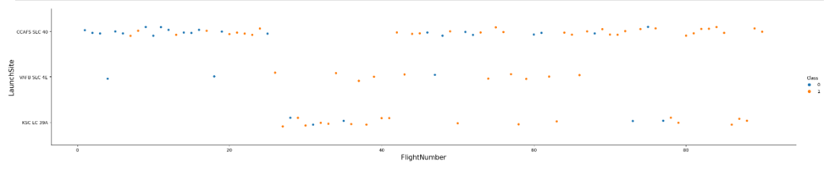

Flight Number vs. Launch Site
A launch site with a higher number of flights tends to have a higher success rate

Slide 20
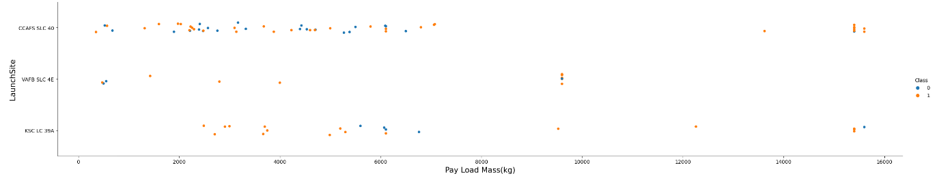
Payload vs. Launch Site
CCAFS SLC 40
The heavier the payload mass, higher the success rate for the rocket launch
VAFB SLC 4E
There’s no success rate launching from this site using payloads heavier than 10000 Kg
KSC LC 35A
Success rate is higher when using payloads with a mass between 2000 and 4000 Kg

Slide 21
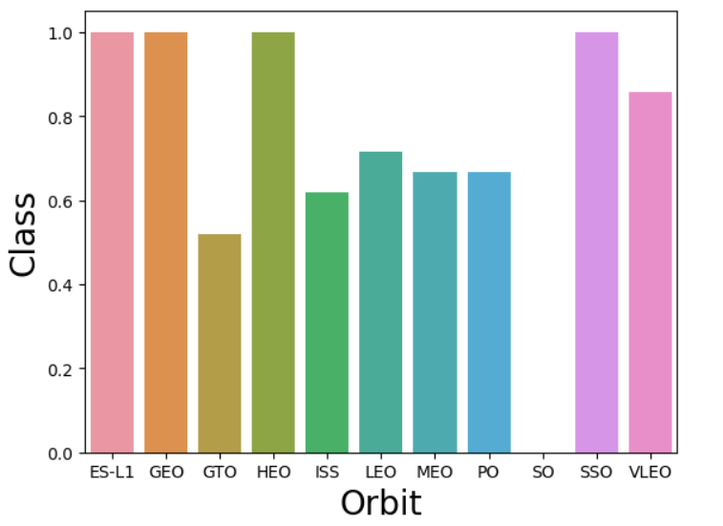
Success Rate vs. Orbit Type
Orbits with the higher success rate
ES-L1, GEO, HEO, SSO, VLEO

Slide 22
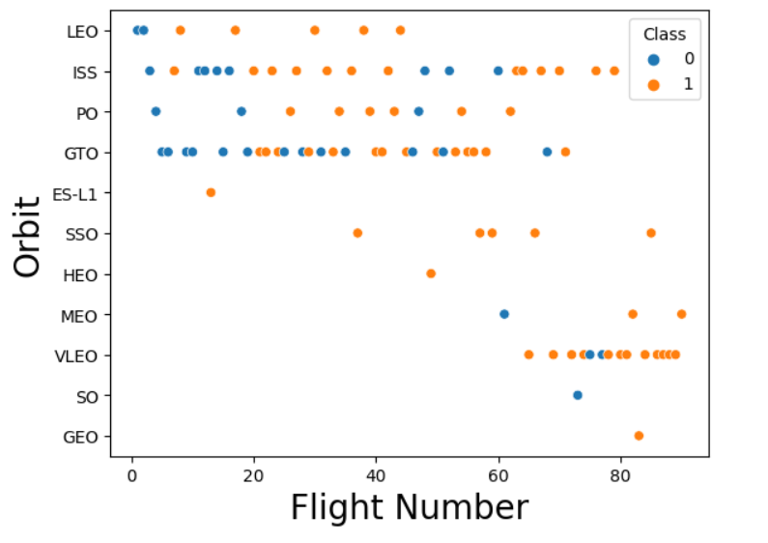
Flight Number vs. Orbit Type
In the LEO orbit the success rate appears related to the number of flights; on the other hand, there seems to be no relationship between flight number when in GTO orbit.

Slide 23
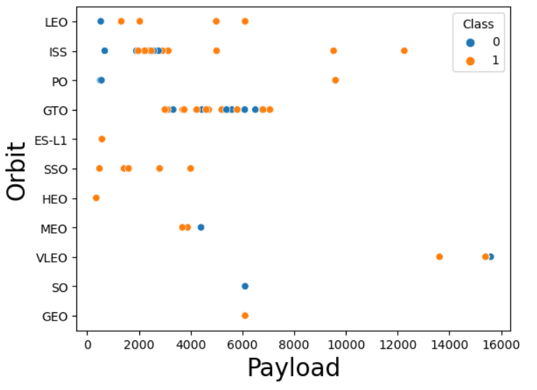
Payload vs. Orbit Type
With heavy payloads the successful landing or positive landing rate are more for Polar, LEO and ISS. However, for GTO we cannot distinguish this well as both positive landing rate and negative landing are both present.

Slide 24
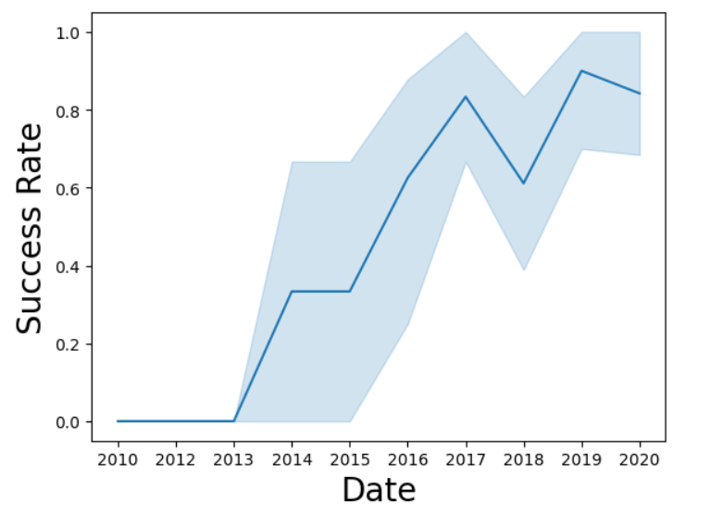
Launch Success Yearly Trend
The success rate since 2013 kept increasing till 2020

Slide 25
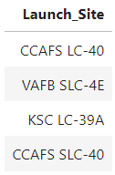
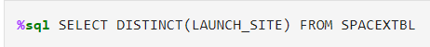
All Launch Site Names
The DISTINCT keyword in the SQL statement returns ONLY the launch sites from the SpaceX dataset

Slide 26
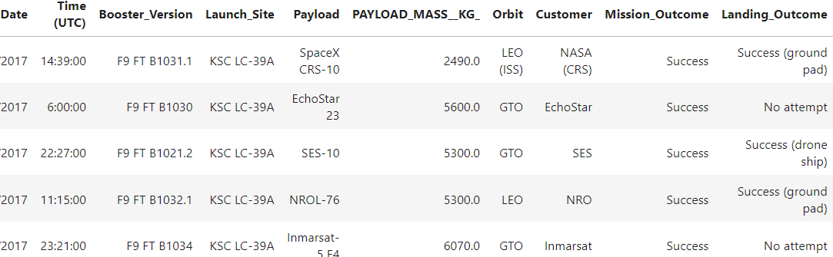
Launch Site Names Begin with 'KSC'
We limit our query to search and retrieve only 5 records from the data set, where the launch site name begins with “KSC”

Slide 27
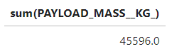
Total Payload Mass
Total payload mass (kg) carried by boosters launched by NASA (CRS)

Slide 28
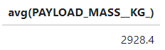
Average Payload Mass by F9 v1.1
Average payload mass (kg) carried by booster version F9 v1.1

Slide 29
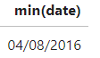
First Successful Ground Landing Date
The first successful landing outcome on drone ship was on 04/08/2016
Retrieve the earliest date (min(date)) from the SpaceX dataset when the first successful landing outcome in a drone ship was achieved.

Slide 30
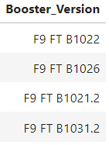
Successful Drone Ship Landing with Payload between 4000 and 6000
Name of boosters which have successfully landed on drone ship and had payload mass greater than 4000 but less than 6000 (BETWEEN clause allow us to select intervals of data)

Slide 31
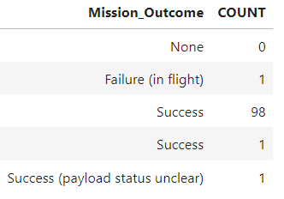
Total Number of Successful and Failure Mission Outcomes

Slide 32
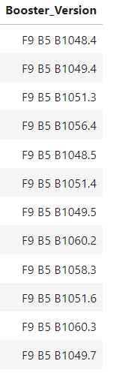
Boosters Carried Maximum Payload
Names of the booster which have carried the maximum payload mass from the SpaceX dataset
Firstly, we filter the dataset to include only the data related to the booster version. Afterward, we utilize a query to retrieve the maximum value from the "payload_mass_kg" column.

Slide 33
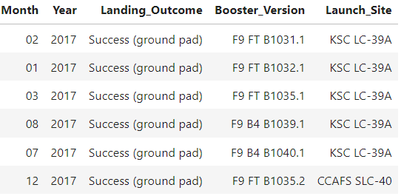
2017 Launch Records
Records which will display the month names, successful landing outcomes in ground pad ,booster versions, launch site for the months in year 2017
Since SQLLite does not support month names. We need to use substr(Date, 4, 2) as month to get the months and substr(Date,7,4)='2017' for year.

Slide 34
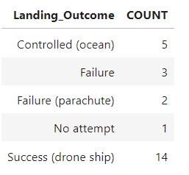
Rank Landing Outcomes Between 2010-06-04 and 2017-03-20
Count of landing outcomes (such as Failure (drone ship) or Success (ground pad)) between the date 2010-06-04 and 2017-03-20, in descending order

Slide 35

Section 3

Slide 36
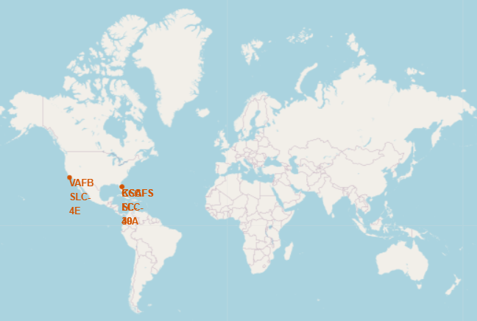
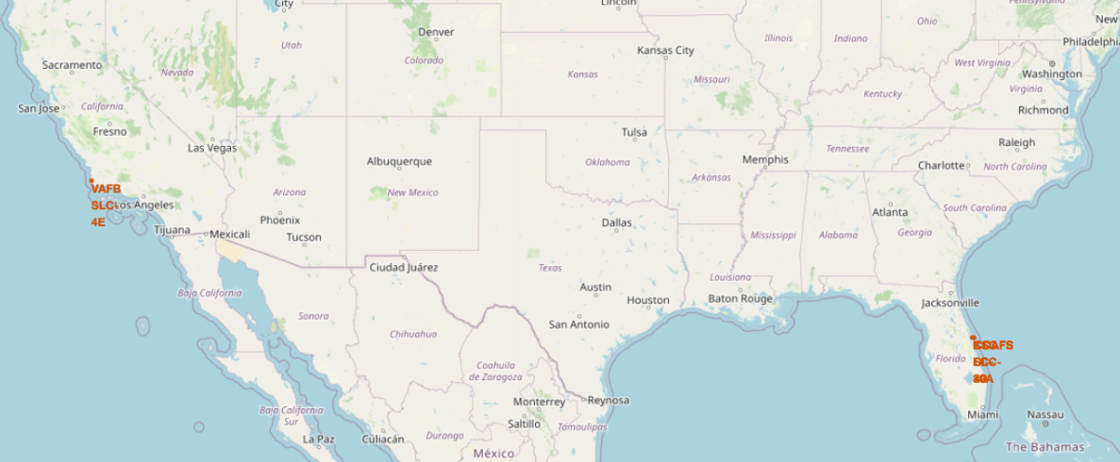
SpaceX marked launch locations
We have incorporated both a marker (folium.Marker) and a circle (folium.Circle) to enable easy identification of each location on the world map.

Slide 37
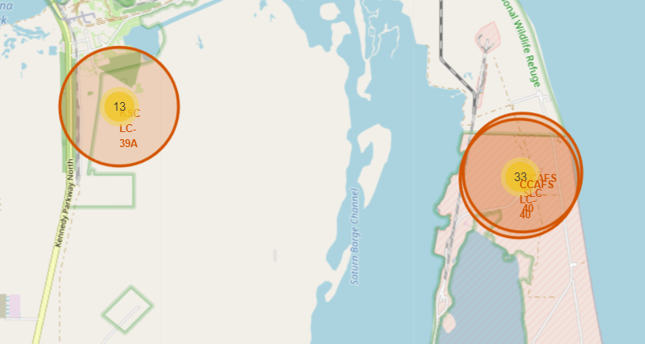
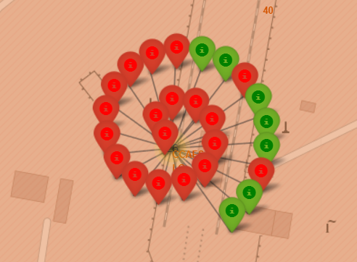
Launch Outcome Markers by location
We created Marker clusters because it can be a good way to simplify a map containing many markers having the same coordinate.
We also added color markers in order to identify the success/fail of the launches in a specific site
(Green = Successful, Red = Failed)

Slide 38
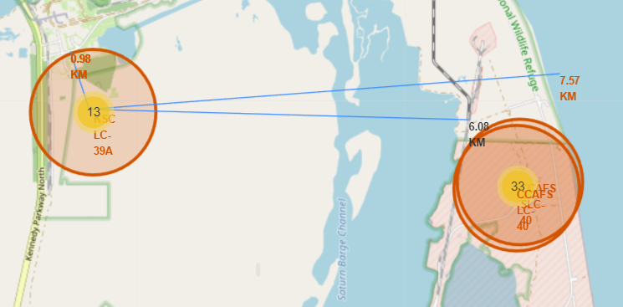
Launch Site Proximities
Searched for the closest railway, highway and coastline,
Marked down their coordinates,
Draw a line (PolyLine) from each of the closest point of interest to the launch site, using the coordinates,
Calculated the distance of each point to the launch site.
These steps will allow us to answer the following questions:
Are launch sites in close proximity to railways?
Are launch sites in close proximity to highways?
Are launch sites in close proximity to coastline?
Do launch sites keep certain distance away from cities?

Slide 39

Section 4

Slide 40
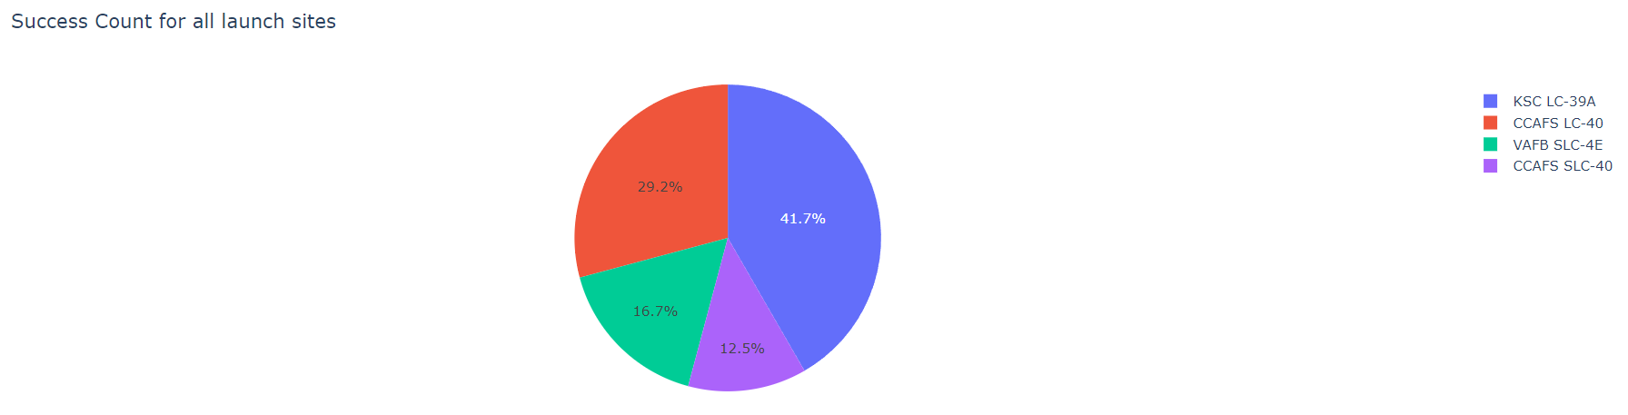
The success rate of SpaceX launches at each site
KSC LC-39A had the highest number of successful launches among all the sites

Slide 41
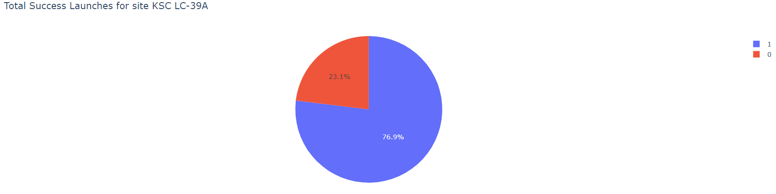
Total Launches for KSC LC-39A
The success rate for KSC LC-39A site is 76,9%

Slide 42
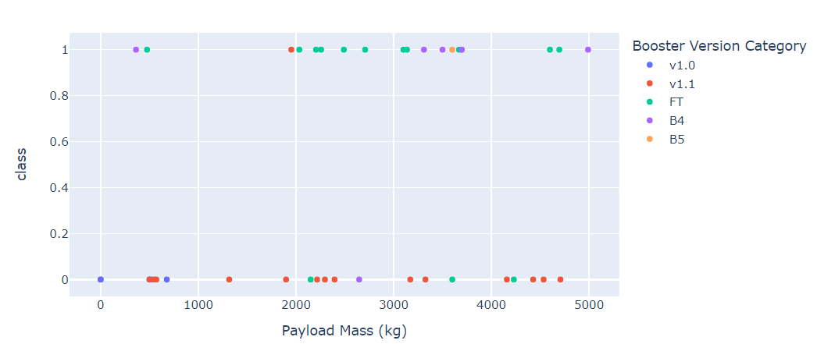
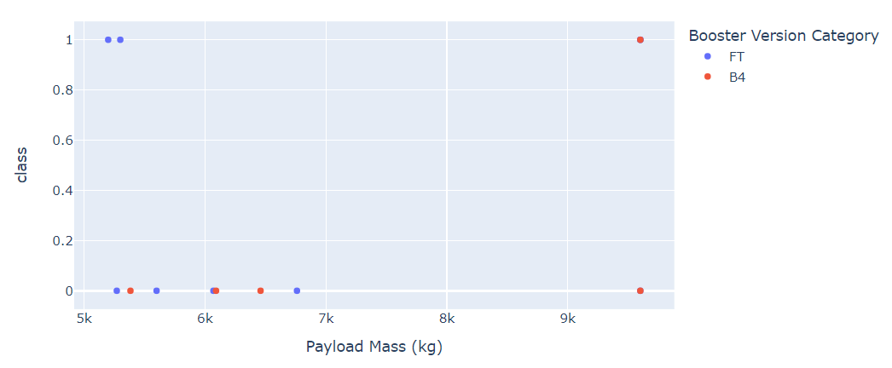
Correlation between payload and launch success
Payload mass 0 – 5000 Kg
Payload mass 5000 – 10000 Kg
For lower weight payloads, the success rate is significantly higher compared to higher weight payloads

Slide 43

Section 5

Slide 44
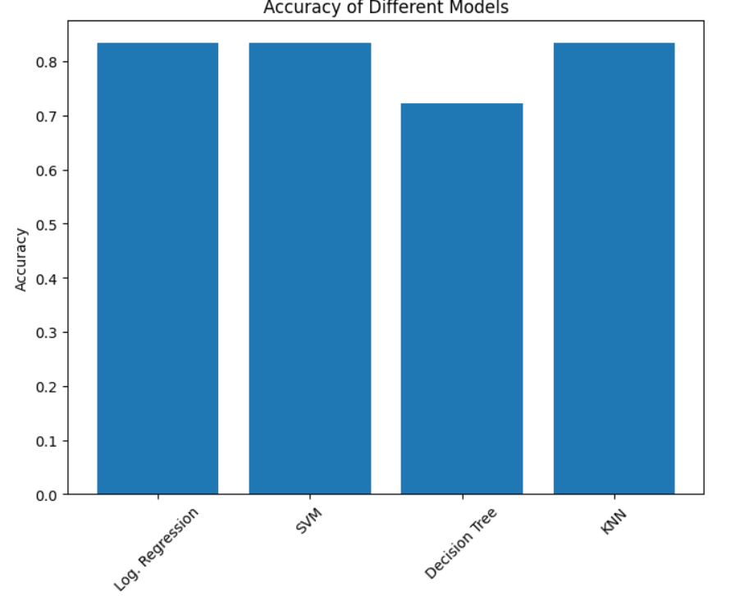
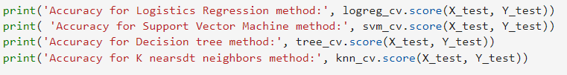
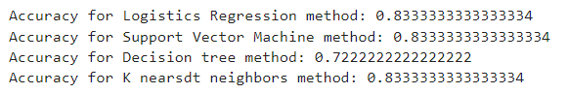
Classification Accuracy
Best performing models with similar accuracy of 83,3%
Logistic Regression
SVM
KNN

Slide 45
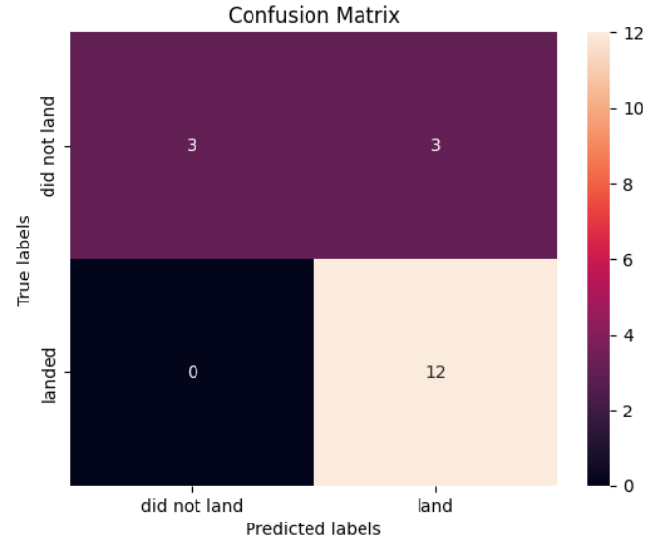
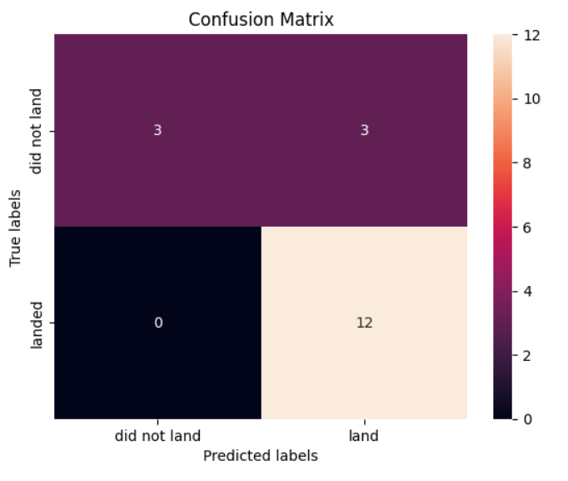
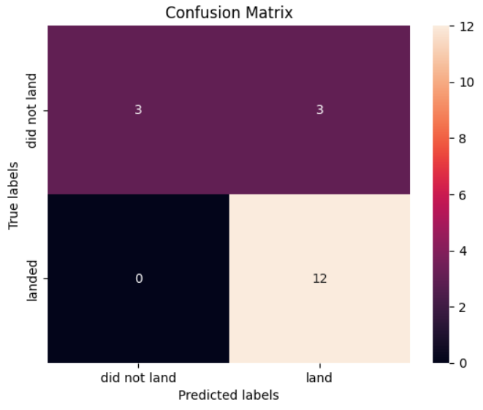
Confusion Matrix
Logistic Regression
SVM
KNN
We achieved a high accuracy with 15 out of 18 observations correctly classified (83.33%). The model displayed robust performance in correctly identifying successful rocket landings (True Positive = 12) while making a few misclassifications for unsuccessful landings (False Positive = 3).

Slide 46
Conclusions
The success rates for SpaceX launches are proportional to the number of years they have been conducting launches.
Orbits, such as ES-L1, GEO, HEO, SSO, and VLEO, exhibit higher success rates in SpaceX launches.
KSC LC 39A stands out as the site with the highest number of successful launches
Lighter payloads tend to have a higher success rate, leading to more successful launches
Logistic regression, SVM, and KNN machine learning algorithms demonstrate to have the best accuracy when applied to the SpaceX dataset.

Slide 47


